Slide 1
Catholic Schools Day 2021

Slide 2
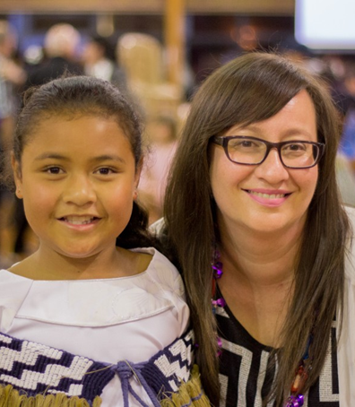
What is Catholic Schools Day?
Catholic Schools Day is celebrated every three years to:
Support pride in our Catholic school and the network of Catholic schools.
Encourage schools to find out more about the network of Catholic schools throughout the country.
Invite the wider community to share in and see what Catholic schools are about.
Have fun and enjoyment with our school whānau and if possible with other schools.
Help us to celebrate the taonga of Catholic Education in Aotearoa.
Notes:
We are celebrating a year earlier than usual due to the National Catholic Education Convention belong postponed from 2021 to 2022.

Slide 3
What is the theme for this year?
Our 2021 theme of Tūrangawaewae: Catholic Schools-A Place to Stand reminds us that:
It is through our baptism we become te whānau whakapono.
Our school and parish is a place where we feel connected and inspired.
Our school is a place to strengthen our faith and commitment to te whānau whakapono.
Pope Francis calls us to be companions on this journey.
Find out more information about the theme
Notes:
Tūrangawaewae is the understanding that we have places where we feel connected and inspired. It is a place of security and foundation.
Through our baptism we become part of the faithful, te whānau whakapono, and through our baptism we find a place to stand which is woven through our stories that connect us together to the land, to our tūrangawaewae.
Foundations and connections to faith are strengthened in our Catholic schools which are an integral part of the wider Church. It is here that children, their whānau, and teachers strengthen their sense of what it means to be Catholic and belonging to parish. School and parish become tūrangawaewae.
Belonging gives us a home with others so that we share a vision, a place where we are helped to care for others and others care for us. The joy and energy that come from caring for one another creates the ‘us’. In doing so, together, our humanity is strengthened.
We do not thrive in isolation: we need community that supports and helps us to learn to be a gift of self to others, and to seek the best for them.

Slide 4
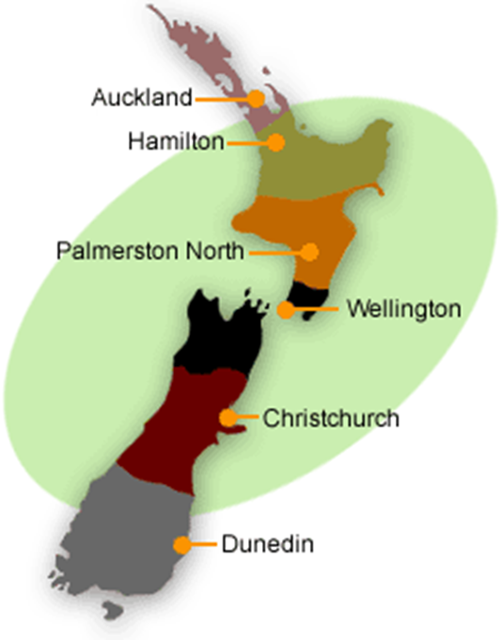
Why do we celebrate Catholic Schools Day?
Pompallier Catholic School, Kaitaia and Pompallier College, Whangarei are the most northern primary and secondary schools
To develop a sense of connectedness to our wider te whānau whakapono throughout Aotearoa
If possible join with other schools and get to know new people
St Theresa’s School, Bluff
Verdon College, Invercargill are the most southern schools
Notes:
Whether we are a large, small, or remote school we all part of the same whānau whakapono (faith family)
We have large schools (St Peter’s College, Auckland) and small schools ( St Joseph’s School in Matata), schools that are dedicated to Māori students (St Joseph’s Māori Girls College, Napier and Hato Pāora out from Feilding). Schools that are a long way from others (St John’s School, Ranfurly in Central Otago).
Our most northern primary School is Pompallier School Kaitaia and most northern college is Pompallier College Whangārei.
Our most southern schools are St Theresa’s School Bluff and Verdon College Invercargill
Though different we all have the same aim to allow us to get to know Jesus Christ and to grow in knowledge of His teachings and from that to be a Christian witness in our families, within our school and in the wider community.

Slide 5
How many Catholic schools are there?
The largest number of primary and secondary schools are in Auckland, followed by Wellington.
The total number of primary schools is 187.
The total number of secondary schools is 48.
We have 235 Catholic schools in New Zealand.

Slide 6
Who comes to our schools?
We have a diverse range of cultures in our schools

Slide 7
Why is it important to celebrate?
It is important because it gets us all thinking about each other and:
It reminds us that the experience of Catholic education is about much more than subjects in the classroom.
We are all part of a long and great tradition.
Watch the video to see what others value about being at a Catholic School:

